Slide 1
Process and process Scheduling

Slide 2
Process Concept
A batch system executes jobs, whereas a time-shared system has user programs, or tasks. Even on a single-user system, a user may be able to run several programs at one time: a word processor, a Web browser, and an e-mail package.
And even if a user can execute only one program at a time, such as on an embedded device that does not support multitasking, the operating system may need to support its own internal programmed activities, such as memory management.
In many respects, all these activities are similar, so we call all of them processes.
Although we personally prefer the term process, much of operating-system theory and terminology was developed during a time when the major activity of operating systems was job processing.

Slide 3
The Process
Informally, a process is a program in execution. A process is more than the program code, which is sometimes known as the text section.
It also includes the current activity, as represented by the value of the program counter and the contents of the processor’s registers.
A process generally also includes the process stack, which contains temporary data (such as function parameters, return addresses, and local variables), and a data section, which contains global variables.
A process may also include a heap, which is memory that is dynamically allocated during process run time.

Slide 4
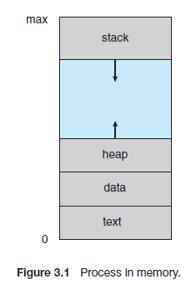
The structure of a process in memory is shown in Figure 3.1.

Slide 5
We emphasize that a program by itself is not a process. A program is a passive entity, such as a file containing a list of instructions stored on disk (often called an executable file).
In contrast, a process is an active entity, with a program counter specifying the next instruction to execute and a set of associated resources. A program becomes a process when an executable file is loaded into memory.
Two common techniques for loading executable files are double-clicking an icon representing the executable file and entering the name of the executable file on the command line (as in prog.exe or a.out).

Slide 6
Although two processes may be associated with the same program, they are nevertheless considered two separate execution sequences. For instance, several users may be running different copies of the mail program, or the same user may invoke many copies of the web browser program.
Each of these is a separate process; and although the text sections are equivalent, the data, heap, and stack sections vary. It is also common to have a process that spawns many processes as it runs.
Note that a process itself can be an execution environment for other code. The Java programming environment provides a good example.
In most circumstances, an executable Java program is executed within the Java virtual machine (JVM). The JVM executes as a process that interprets the loaded Java code and takes actions (via native machine instructions) on behalf of that code.
For example, to run the compiled Java program Program.class, we would enter java Program
The command java runs the JVM as an ordinary process, which in turns executes the Java program Program in the virtual machine.

Slide 7
Process State
As a process executes, it changes state. The state of a process is defined in part by the current activity of that process. A process may be in one of the following states:
• New. The process is being created.
• Running. Instructions are being executed.
• Waiting. The process is waiting for some event to occur (such as an I/O completion or reception of a signal).
• Ready. The process is waiting to be assigned to a processor.
• Terminated. The process has finished execution.
These names are arbitrary, and they vary across operating systems.
It is important to realize that only one process can be running on any processor at any instant.
Many processes may be ready and waiting, however. The state diagram corresponding to these states is presented in Figure 3.2.

Slide 8
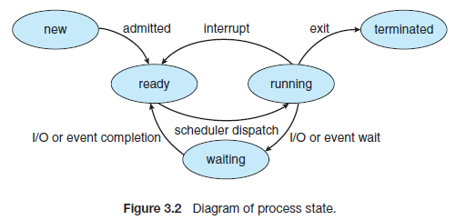

Slide 9
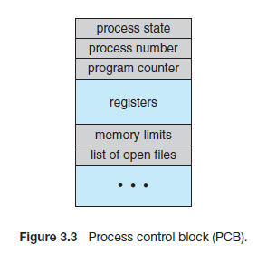
Process Control Block
Each process is represented in the operating system by a process control block (PCB)—also called a task control block.
A PCB is shown in Figure 3.3.

Slide 10
It contains many pieces of information associated with a specific process, including these:
• Process state. The state may be new, ready, running, waiting, halted, and so on.
• Program counter. The counter indicates the address of the next instruction to be executed for this process.
• CPU registers. The registers vary in number and type, depending on the computer architecture.
They include accumulators, index registers, stack pointers, and general-purpose registers, plus any condition-code information.
Along with the program counter, this state information must be saved when an interrupt occurs, to allow the process to be continued correctly afterward (Figure 3.4).

Slide 11
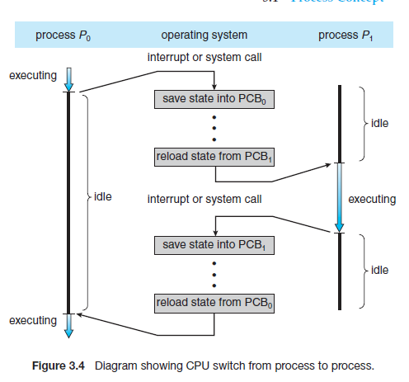

Slide 12
• CPU-scheduling information. This information includes a process priority, pointers to scheduling queues, and any other scheduling parameters.
• Memory-management information. This information may include such items as the value of the base and limit registers and the page tables, or the segment tables, depending on the memory system used by the operating System .
• Accounting information. This information includes the amount of CPU
and real time used, time limits, account numbers, job or process numbers,
and so on.
• I/O status information. This information includes the list of I/O devices
allocated to the process, a list of open files, and so on.

Slide 13
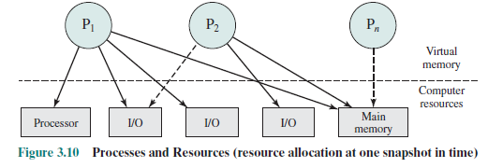
PROCESS DESCRIPTION
The OS controls events within the computer system. It schedules and dispatches processes for execution by the processor, allocates resources to processes, and responds to requests by user processes for basic services.
Fundamentally, we can think of the OS as that entity that manages the use of system resources by processes.
This concept is illustrated in Figure 3.10 .

Slide 14
In a multiprogramming environment, there are a number of processes (P 1 ,…, P n ) that have been created and exist in virtual memory.
Each process, during the course of its execution, needs access to certain system resources, including the processor, I/O devices, and main memory.
In the figure, process P 1 is running; at least part of the process is in main memory, and it has control of two I/O devices. Process P 2 is also in main memory but is blocked waiting for an I/O device allocated to P 1 .
Process P n has been swapped out and is therefore suspended.
Here we are concerned with a more fundamental question: What information does the OS need to control processes and manage resources for them?

Slide 15
Operating System Control Structures
If the OS is to manage processes and resources, it must have information about the current status of each process and resource.
The universal approach to providing this information is straightforward: The OS constructs and maintains tables of information about each entity that it is managing.
A general idea of the scope of this effort is indicated in Figure 3.11 , which shows four different types of tables maintained by the OS: memory, I/O, file, and process.

Slide 16
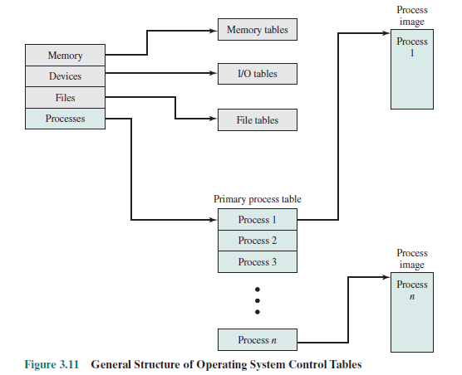

Slide 17
Although the details will differ from one OS to another, fundamentally, all operating systems maintain information in these four categories.
Memory tables are used to keep track of both main (real) and secondary (virtual) memory. Some of main memory is reserved for use by the OS; the remainder is available for use by processes.
Processes are maintained on secondary memory using some sort of virtual memory or simple swapping mechanism.
The memory tables must include the following information:
• The allocation of main memory to processes
• The allocation of secondary memory to processes
• Any protection attributes of blocks of main or virtual memory, such as which processes may access certain shared memory regions
• Any information needed to manage virtual memory

Slide 18
I/O tables are used by the OS to manage the I/O devices and channels of the computer system. At any given time, an I/O device may be available or assigned to a particular process.
If an I/O operation is in progress, the OS needs to know the status of the I/O operation and the location in main memory being used as the source or destination of the I/O transfer.
The OS may also maintain file tables . These tables provide information about the existence of files, their location on secondary memory, their current status, and other attributes. Much, if not all, of this information may be maintained and used by a file management system, in which case the OS has little or no knowledge of files.
In other operating systems, much of the detail of file management is managed by the OS itself.
Finally, the OS must maintain process tables to manage processes.

Slide 19
Process Control Structures
Consider what the OS must know if it is to manage and control a process. First, it must know where the process is located; second, it must know the attributes of the process that are necessary for its management (e.g., process ID and process state).
PROCESS LOCATION
At a minimum, a process must include a program or set of programs to be executed. Associated with these programs is a set of data locations for local and global variables and any defined constants.
Thus, a process will consist of at least sufficient memory to hold the programs and data of that process. In addition, the execution of a program typically involves a stack that is used to keep track of procedure calls and parameter passing between procedures.
Finally, each process has associated with it a number of attributes that are used by the OS for process control. Typically, the collection of attributes is referred to as a process control block. We can refer to this collection of program, data, stack, and attributes as the process image.

Slide 20
The location of a process image will depend on the memory management scheme being used. In the simplest case, the process image is maintained as a contiguous, or continuous, block of memory.
This block is maintained in secondary memory, usually disk. So that the OS can manage the process, at least a small portion of its image must be maintained in main memory. To execute the process, the entire process image must be loaded into main memory or at least virtual memory.
Thus, the OS needs to know the location of each process on disk and, for each such process that is in main memory, the location of that process in main memory.
Modern operating systems presume paging hardware that allows noncontiguous physical memory to support partially resident processes. At any given time, a portion of a process image may be in main memory, with the remainder in secondary memory. Therefore, process tables maintained by the OS must show the location of each page of each process image.

Slide 21
Figure 3.11 depicts the structure of the location information in the following way.
There is a primary process table with one entry for each process. Each entry contains, at least, a pointer to a process image.
If the process image contains multiple blocks, this information is contained directly in the primary process table or is available by cross-reference to entries in memory tables.
Of course, this depiction is generic; a particular OS will have its own way of organizing the location information.

Slide 22
PROCESS ATTRIBUTES
A sophisticated multiprogramming system requires a great deal of information about each process. As was explained, this information can be considered to reside in a process control block.
We can group the process control block information into three general categories:
• Process identification
• Processor state information
• Process control information

Slide 23
With respect to process identification , in virtually all operating systems, each process is assigned a unique numeric identifier, which may simply be an index into the primary process table ; otherwise there must be a mapping that allows the OS to locate the appropriate tables based on the process identifier.
This identifier is useful in several ways. Many of the other tables controlled by the OS may use process identifiers to cross-reference process tables.
For example, the memory tables may be organized so as to provide a map of main memory with an indication of which process is assigned to each region.
Similar references will appear in I/O and file tables. When processes communicate with one another, the process identifier informs the OS of the destination of a particular communication.
When processes are allowed to create other processes, identifiers indicate the parent and descendents of each process.
In addition to these process identifiers, a process may be assigned a user identifier that indicates the user responsible for the job.

Slide 24
Processor state information consists of the contents of processor registers.
While a process is running, of course, the information is in the registers. When a process is interrupted, all of this register information must be saved so that it can be restored when the process resumes execution.
The nature and number of registers involved depend on the design of the processor. Typically, the register set will include user-visible registers, control and status registers, and stack pointers.
Of particular note, all processor designs include a register or set of registers, often known as the program status word (PSW), that contains status information.
The PSW typically contain condition codes plus other status information.

Slide 25
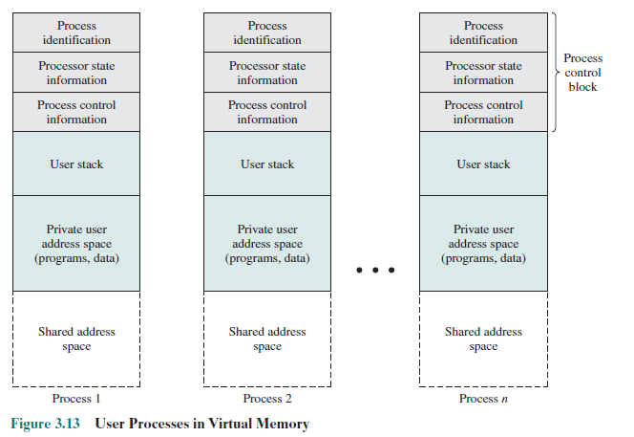
The third major category of information in the process control block can be called, process control information .
This is the additional information needed by the OS to control and coordinate the various active processes.
Figure 3.13 suggests the structure of process images in virtual memory.

Slide 26
Each process image consists of a process control block, a user stack, the private address space of the process, and any other address space that the process shares with other processes.
In the figure, each process image appears as a contiguous range of addresses. In an actual implementation, this may not be the case; it will depend on the memory management scheme and the way in which control structures are organized by the OS.
The process control block may contain structuring information, including pointers that allow the linking of process control blocks.
Thus, the queues could be implemented as linked lists of process control blocks. For example, the queueing structure could be implemented as suggested in Figure 3.14 .

Slide 27
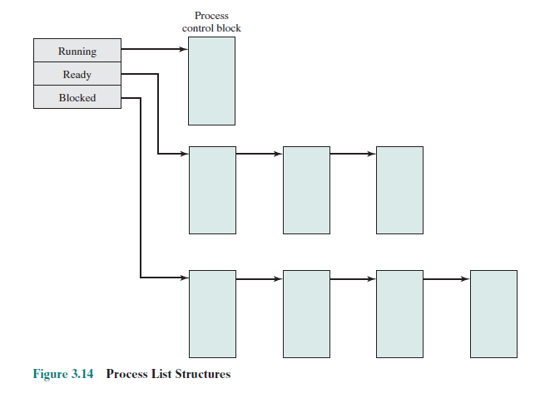

Slide 28
THE ROLE OF THE PROCESS CONTROL BLOCK
The process control block is the most important data structure in an OS.
Each process control block contains all of the information about a process that is needed by the OS.
The blocks are read and/or modified by virtually every module in the OS, including those involved with scheduling, resource allocation, interrupt processing, and performance monitoring and analysis.
One can say that the set of process control blocks defines the state of the OS.
This brings up an important design issue. A number of routines within the OS will need access to information in process control blocks. The provision of direct access to these tables is not difficult.

Slide 29
Each process is equipped with a unique ID, and this can be used as an index into a table of pointers to the process control blocks.
The difficulty is not access but rather protection. Two problems present themselves:
• A bug in a single routine, such as an interrupt handler, could damage process control blocks, which could destroy the system’s ability to manage the affected processes.
• A design change in the structure or semantics of the process control block could affect a number of modules in the OS.
These problems can be addressed by requiring all routines in the OS to go through a handler routine, the only job of which is to protect process control blocks, and which is the sole arbiter for reading and writing these blocks.
The trade-off in the use of such a routine involves performance issues and the degree to which the remainder of the system software can be trusted to be correct.

Slide 30
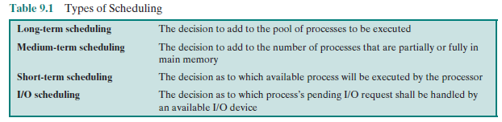
UNIPROCESSOR SCHEDULING
In a multiprogramming system, multiple processes exist concurrently in main memory.
Each process alternates between using a processor and waiting for some event to occur, such as the completion of an I/O operation.
The processor or processors are kept busy by executing one process while the others wait.
The key to multiprogramming is scheduling. In fact, four types of scheduling are typically involved ( Table 9.1 ).

Slide 31
TYPES OF PROCESSOR SCHEDULING
The aim of processor scheduling is to assign processes to be executed by the processor or processors over time, in a way that meets system objectives, such as response time, throughput, and processor efficiency.
In many systems, this scheduling activity is broken down into three separate functions: long-, medium-, and short-term scheduling.
The names suggest the relative time scales with which these functions are performed.
Long-term scheduling is performed when a new process is created. This is a decision whether to add a new process to the set of processes that are currently active.
Medium-term scheduling is a part of the swapping function. This is a decision whether to add a process to those that are at least partially in main memory and therefore available for execution.
Short-term scheduling is the actual decision of which ready process to execute next. Figure 9.2 reorganizes the state transition diagram of Figure 3.9b to suggest the nesting of scheduling functions.
Scheduling affects the performance of the system because it determines which processes will wait and which will progress.
Fundamentally, scheduling is a matter of managing queues to minimize queueing delay and to optimize performance in a queueing environment.

Slide 32
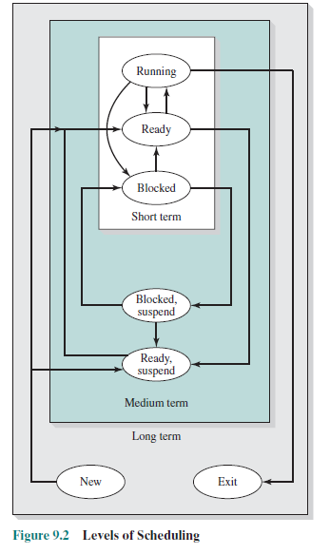

Slide 33
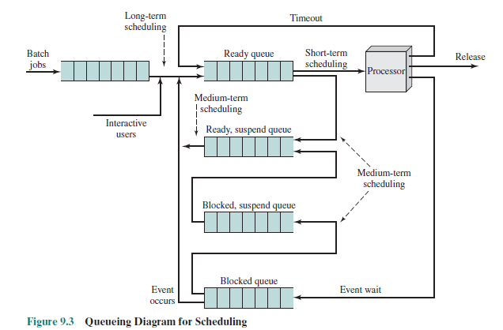

Slide 34
Long-Term Scheduling
The long-term scheduler determines which programs are admitted to the system for processing. Thus, it controls the degree of multiprogramming.
Once admitted, a job or user program becomes a process and is added to the queue for the short-term scheduler.
In some systems, a newly created process begins in a swapped-out condition, in which case it is added to a queue for the medium-term scheduler.
In a batch system, or for the batch portion of an OS, newly submitted jobs are routed to disk and held in a batch queue.
The long-term scheduler creates processes from the queue when it can. There are two decisions involved.

Slide 35
The scheduler must decide when the OS can take on one or more additional processes. And the scheduler must decide which job or jobs to accept and turn into processes.
The decision as to when to create a new process is generally driven by the desired degree of multiprogramming. The more processes that are created, the smaller is the percentage of time that each process can be executed (i.e., more processes are competing for the same amount of processor time).
Thus, the long-term scheduler may limit the degree of multiprogramming to provide satisfactory service to the current set of processes.
Each time a job terminates, the scheduler may decide to add one or more new jobs. Additionally, if the fraction of time that the processor is idle exceeds a certain threshold, the long-term scheduler may be invoked.

Slide 36
The decision as to which job to admit next can be on a simple first-come-first-served (FCFS) basis, or it can be a tool to manage system performance. The criteria used may include priority, expected execution time, and I/O requirements.
For example, if the information is available, the scheduler may attempt to keep a mix of processor-bound and I/O-bound processes. Also, the decision can depend on which I/O resources are to be requested, in an attempt to balance I/O usage.
For interactive programs in a time-sharing system, a process creation request can be generated by the act of a user attempting to connect to the system.
Time-sharing users are not simply queued up and kept waiting until the system can accept them. Rather, the OS will accept all authorized comers until the system is saturated, using some predefined measure of saturation.
At that point, a connection request is met with a message indicating that the system is full and the user should try again later.

Slide 37
Medium-Term Scheduling
Medium-term scheduling is part of the swapping function.
Typically, the swapping-in decision is based on the need to manage the degree of multiprogramming.
On a system that does not use virtual memory, memory management is also an issue.
Thus, the swapping-in decision will consider the memory requirements of the swapped-out processes.

Slide 38
Short-Term Scheduling
In terms of frequency of execution, the long-term scheduler executes relatively infrequently and makes the coarse-grained decision of whether or not to take on a new process and which one to take.
The medium-term scheduler is executed somewhat more frequently to make a swapping decision.
The short-term scheduler, also known as the dispatcher, executes most frequently and makes the fine-grained decision of which process to execute next.
The short-term scheduler is invoked whenever an event occurs that may lead to the blocking of the current process or that may provide an opportunity to preempt a currently running process in favor of another. Examples of such events include:
• Clock interrupts
• I/O interrupts
• Operating system calls
• Signals (e.g., semaphores)

Slide 39
SCHEDULING ALGORITHMS
Short-Term Scheduling Criteria
The main objective of short-term scheduling is to allocate processor time in such a way as to optimize one or more aspects of system behavior. Generally, a set of criteria is established against which various scheduling policies may be evaluated.
The commonly used criteria can be categorized along two dimensions. First, we can make a distinction between user-oriented and system-oriented criteria.
User oriented criteria relate to the behavior of the system as perceived by the individual user or process. An example is response time in an interactive system.
Response time is the elapsed time between the submission of a request until the response begins to appear as output. This quantity is visible to the user and is naturally of interest to the user. We would like a scheduling policy that provides “good” service to various users. In the case of response time, a threshold may be defined, say two seconds. Then a goal of the scheduling mechanism should be to maximize the number of users who experience an average response time of two seconds or less.

Slide 40
Other criteria are system oriented. That is, the focus is on effective and efficient utilization of the processor.
An example is throughput, which is the rate at which processes are completed. This is certainly a worthwhile measure of system performance and one that we would like to maximize.
However, it focuses on system performance rather than service provided to the user. Thus, throughput is of concern to a system administrator but not to the user population.
Whereas user-oriented criteria are important on virtually all systems, system oriented criteria are generally of minor importance on single-user systems. On a single-user system, it probably is not important to achieve high processor utilization or high throughput as long as the responsiveness of the system to user applications is acceptable.

Slide 41
Another dimension along which criteria can be classified is those that are performance related and those that are not directly performance related.
Performance related criteria are quantitative and generally can be readily measured. Examples include response time and throughput.
Criteria that are not performance related are either qualitative in nature or do not lend themselves readily to measurement and analysis. An example of such a criterion is predictability.
We would like for the service provided to users to exhibit the same characteristics over time, independent of other work being performed by the system. To some extent, this criterion can be measured by calculating variances as a function of workload.
However, this is not nearly as straightforward as measuring throughput or response time as a function of workload.

Slide 42
Key scheduling criteria are interdependent, and it is impossible to optimize all of them simultaneously.
For example, providing good response time may require a scheduling algorithm that switches between processes frequently. This increases the overhead of the system, reducing throughput.
Thus, the design of a scheduling policy involves compromising among competing requirements; the relative weights given the various requirements will depend on the nature and intended use of the system.
In most interactive operating systems, whether single user or time shared, adequate response time is the critical requirement.

Slide 43
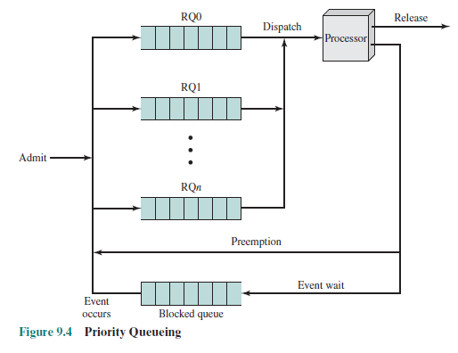
The Use of Priorities
In many systems, each process is assigned a priority and the scheduler will always choose a process of higher priority over one of lower priority. Figure 9.4 illustrates the use of priorities.

Slide 44
For clarity, the queueing diagram is simplified, ignoring the existence of multiple blocked queues and of suspended states. Instead of a single ready queue, we provide a set of queues, in descending order of priority:
RQ0, RQ1, . . . , RQ n , with priority[RQ i ] > priority[RQ j ] for i > j .
When a scheduling selection is to be made, the scheduler will start at the highest-priority ready queue(RQ0). If there are one or more processes in the queue, a process is selected using some scheduling policy.
If RQ0 is empty, then RQ1 is examined, and so on.
One problem with a pure priority scheduling scheme is that lower-priority processes may suffer starvation.
This will happen if there is always a steady supply of higher-priority ready processes. If this behavior is not desirable, the priority of a process can change with its age or execution history.

Slide 45
Alternative Scheduling Policies
The selection function determines which process, among ready processes, is selected next for execution. The function may be based on priority, resource requirements, or the execution characteristics of the process. In the latter case, three quantities are significant:
w = time spent in system so far, waiting
e = time spent in execution so far
s = total service time required by the process, including e ; generally, this quantity must be estimated or supplied by the user
For example, the selection function max[ w ] indicates an FCFS discipline.

Slide 46
The decision mode specifies the instants in time at which the selection function is exercised. There are two general categories:
• Nonpreemptive: In this case, once a process is in the Running state, it continues to execute until (a) it terminates or (b) it blocks itself to wait for I/O or to request some OS service.
• Preemptive: The currently running process may be interrupted and moved to the Ready state by the OS. The decision to preempt may be performed when a new process arrives; when an interrupt occurs that places a blocked process in the Ready state; or periodically, based on a clock interrupt.
Preemptive policies incur greater overhead than nonpreemptive ones but may provide better service to the total population of processes, because they prevent any one process from monopolizing the processor for very long.
In addition, the cost of preemption may be kept relatively low by using efficient process-switching mechanisms (as much help from hardware as possible) and by providing a large main memory to keep a high percentage of programs in main memory.

Slide 47
In terms of the queueing model, turnaround time (TAT) is the residence time Tr , or total time that the item spends in the system (waiting time plus service time).
A more useful figure is the normalized turnaround time, which is the ratio of turnaround time to service time.
This value indicates the relative delay experienced by a process. Typically, the longer the process execution time, the greater is the absolute amount of delay that can be tolerated.
The minimum possible value for this ratio is 1.0; increasing values correspond to a decreasing level of service.

Slide 48
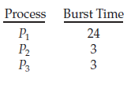
FIRST-COME-FIRST-SERVED
By far the simplest CPU-scheduling algorithm is the first-come, first-served (FCFS) scheduling algorithm. With this scheme, the process that requests the CPU first is allocated the CPU first.
The implementation of the FCFS policy is easily managed with a FIFO queue. When a process enters the ready queue, its PCB is linked onto the tail of the queue.
When the CPU is free, it is allocated to the process at the head of the queue. The running process is then removed from the queue.
The code for FCFS scheduling is simple to write and understand.
On the negative side, the average waiting time under the FCFS policy is often quite long.
Consider the following set of processes that arrive at time 0, with the length of the CPU burst given in milliseconds:

Slide 49


If the processes arrive in the order P1, P2, P3, and are served in FCFS order, we get the result shown in the following Gantt chart, which is a bar chart that illustrates a particular schedule, including the start and finish times of each of the participating processes:
The waiting time is 0 milliseconds for process P1, 24 milliseconds for process P2, and 27 milliseconds for process P3.
Thus, the average waiting time is (0+ 24 + 27)/3 = 17 milliseconds. If the processes arrive in the order P2, P3, P1, however, the results will be as shown in the following Gantt chart:

Slide 50
The average waiting time is now (6 + 0 + 3)/3 = 3 milliseconds. This reduction is substantial. Thus, the average waiting time under an FCFS policy is generally not minimal and may vary substantially if the processes’ CPU burst times vary greatly.
In addition, consider the performance of FCFS scheduling in a dynamic situation. Assume we have one CPU-bound process and many I/O-bound processes.
As the processes flow around the system, the following scenario may result. The CPU-bound process will get and hold the CPU. During this time, all the other processes will finish their I/O and will move into the ready queue, waiting for the CPU.
While the processes wait in the ready queue, the I/O devices are idle. Eventually, the CPU-bound process finishes its CPU burst and moves to an I/O device. All the I/O-bound processes, which have short CPU bursts, execute quickly and move back to the I/O queues.

Slide 51
At this point, the CPU sits idle. The CPU-bound process will then move back to the ready queue and be allocated the CPU. Again, all the I/O processes end up waiting in the ready queue until the CPU-bound process is done.
There is a convoy effect as all the other processes wait for the one big process to get off the CPU. This effect results in lower CPU and device utilization than might be possible if the shorter processes were allowed to go first.
Note also that the FCFS scheduling algorithm is nonpreemptive. Once the CPU has been allocated to a process, that process keeps the CPU until it releases the CPU, either by terminating or by requesting I/O.
The FCFS algorithm is thus particularly troublesome for time-sharing systems, where it is important that each user get a share of the CPU at regular intervals. It would be disastrous to allow one process to keep the CPU for an extended period

Slide 52
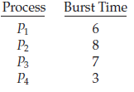
Shortest-Job-First Scheduling
A different approach to CPU scheduling is the shortest-job-first (SJF) scheduling algorithm. This algorithm associates with each process the length of the process’s next CPU burst.
When the CPU is available, it is assigned to the process that has the smallest next CPU burst. If the next CPU bursts of two processes are the same, FCFS scheduling is used to break the tie.
Note that a more appropriate term for this scheduling method would be the shortest-next- CPU-burst algorithm, because scheduling depends on the length of the next CPU burst of a process, rather than its total length.
As an example of SJF scheduling, consider the following set of processes,with the length of the CPU burst given in milliseconds:

Slide 53

Using SJF scheduling, we would schedule these processes according to the following Gantt chart:
The waiting time is 3 milliseconds for process P1, 16milliseconds for process P2, 9milliseconds for process P3, and 0milliseconds for process P4. Thus, the average waiting time is (3 + 16 + 9 + 0)/4 = 7 milliseconds.
By comparison, if we were using the FCFS scheduling scheme, the average waiting time would be 10.25 milliseconds.
The SJF scheduling algorithm is provably optimal, in that it gives the minimum average waiting time for a given set of processes.
Moving a short process before a long one decreases the waiting time of the short process more than it increases the waiting time of the long process. Consequently, the average waiting time decreases.

Slide 54
The real difficulty with the SJF algorithm is knowing the length of the next CPU request. For long-term (job) scheduling in a batch system, we can use the process time limit that a user specifies when he submits the job.
In this situation, users are motivated to estimate the process time limit accurately, since a lower value may mean faster response but too low a value will cause a time-limit-exceeded error and require resubmission.
SJF scheduling is used frequently in long-term scheduling.
Although the SJF algorithm is optimal, it cannot be implemented at the level of short-term CPU scheduling.
With short-term scheduling, there is no way to know the length of the next CPU burst. One approach to this problem is to try to approximate SJF scheduling.
We may not know the length of the next CPU burst, but we may be able to predict its value. We expect that the next CPU burst will be similar in length to the previous ones.

Slide 55

By computing an approximation of the length of the next CPU burst, we can pick the process with the shortest predicted CPU burst.
The next CPU burst is generally predicted as an exponential average of the measured lengths of previous CPU bursts.
We can define the exponential average with the following formula. Let tn be the length of the nth CPU burst, and let “Tn+1 be our predicted value for the next CPU burst. Then, for  , 0 ≤  ≤ 1, define
The value of tn contains our most recent information, while “Tn stores the past history. The parameter # controls the relative weight of recent and past history in our prediction. If  =0, then“Tn+1 = “Tn, and recent history has no effect (current conditions are assumed to be transient). If  =1, then“Tn+1 = tn, and only the most recent CPU burst matters (history is assumed to be old and irrelevant).

Slide 56
More commonly,  = 1/2, so recent history and past history are equally weighted. The initial "0 can be defined as a constant or as an overall system average.
To understand the behavior of the exponential average, we can expand the formula for "n+1 by substituting for "n to find
Typically,  is less than 1. As a result, (1 −  ) is also less than 1, and each successive term has less weight than its predecessor.
The SJF algorithm can be either preemptive or nonpreemptive. The choice arises when a new process arrives at the ready queue while a previous process is still executing.
The next CPU burst of the newly arrived process may be shorter than what is left of the currently executing process. Apreemptive SJF algorithm will preempt the currently executing process, whereas a nonpreemptive SJF algorithm will allow the currently running process to finish its CPU burst.
Preemptive SJF scheduling is sometimes called shortest-remaining-time-first scheduling.

Slide 57
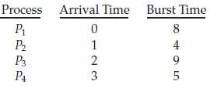

As an example, consider the following four processes, with the length of the CPU burst given in milliseconds:
If the processes arrive at the ready queue at the times shown and need the indicated burst times, then the resulting preemptive SJF schedule is as depicted in the following Gantt chart:
Process P1 is started at time 0, since it is the only process in the queue. Process P2 arrives at time 1.
The remaining time for process P1 (7 milliseconds) is larger than the time required by process P2 (4 milliseconds), so process P1 is preempted, and process P2 is scheduled.
The average waiting time for this example is [(10 − 1) + (1 − 1) + (17 − 2) + (5 − 3)]/4 = 26/4 = 6.5 milliseconds.
Nonpreemptive SJF scheduling would result in an average waiting time of 7.75 milliseconds.

Slide 58
Priority Scheduling
The SJF algorithm is a special case of the general priority-scheduling algorithm.
A priority is associated with each process, and the CPU is allocated to the process with the highest priority. Equal-priority processes are scheduled in FCFS order.
An SJF algorithm is simply a priority algorithm where the priority (p) is the inverse of the (predicted) next CPU burst. The larger the CPU burst, the lower
the priority, and vice versa.
Priorities are generally indicated by some fixed range of numbers, such as 0 to 7 or 0 to 4,095. However, there is no general agreement on whether 0 is the highest or lowest priority.
Some systems use low numbers to represent low priority; others use low numbers for high priority. we assume that low numbers represent high priority.
As an example, consider the following set of processes, assumed to have arrived at time 0 in the order P1, P2, · · ·, P5, with the length of the CPU burst given in milliseconds:

Slide 59
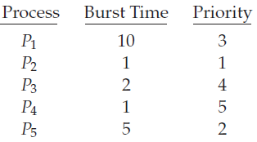

Using priority scheduling, we would schedule these processes according to the following Gantt chart:
The average waiting time is 8.2 milliseconds. Priorities can be defined either internally or externally.
Internally defined priorities use some measurable quantity or quantities to compute the priority of a process. For example, time limits, memory requirements, the number of open files, and the ratio of average I/O burst to average CPU burst have been used in computing priorities.
External priorities are set by criteria outside the operating system, such as the importance of the process, the type and amount of funds being paid for computer use, the department sponsoring the work, and other, often political, factors.

Slide 60
Priority scheduling can be either preemptive or nonpreemptive. When a process arrives at the ready queue, its priority is compared with the priority of the currently running process.
A preemptive priority scheduling algorithm will preempt the CPU if the priority of the newly arrived process is higher than the priority of the currently running process.
A nonpreemptive priority scheduling algorithm will simply put the new process at the head of the ready queue.
A major problem with priority scheduling algorithms is indefinite blocking, or starvation. A process that is ready to run but waiting for the CPU can be considered blocked. A priority scheduling algorithm can leave some lowpriority processes waiting indefinitely.

Slide 61
In a heavily loaded computer system, a steady stream of higher-priority processes can prevent a low-priority process from ever getting the CPU. Generally, one of two things will happen. Either the process will eventually be run (at 2 A.M. Sunday, when the system is finally lightly loaded), or the computer system will eventually crash and lose all unfinished low-priority processes. (Rumor has it that when they shut down the IBM 7094 at MIT in 1973, they found a low-priority process that had been submitted in 1967 and had not yet been run.)
A solution to the problem of indefinite blockage of low-priority processes is aging. Aging involves gradually increasing the priority of processes that wait in the system for a long time.
For example, if priorities range from 127 (low) to 0 (high), we could increase the priority of a waiting process by 1 every 15 minutes. Eventually, even a process with an initial priority of 127 would have the highest priority in the system and would be executed.
In fact, it would take no more than 32 hours for a priority-127 process to age to a priority-0 process.

Slide 62
Round-Robin Scheduling
The round-robin (RR) scheduling algorithm is designed especially for timesharing systems. It is similar to FCFS scheduling, but preemption is added to enable the system to switch between processes.
A small unit of time, called a time quantum or time slice, is defined. A time quantumis generally from10 to 100 milliseconds in length. The ready queue is treated as a circular queue.
The CPU scheduler goes around the ready queue, allocating the CPU to each process for a time interval of up to 1 time quantum.
To implement RR scheduling, we again treat the ready queue as a FIFO queue of processes. New processes are added to the tail of the ready queue.

Slide 63
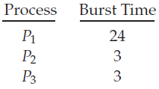
The CPU scheduler picks the first process from the ready queue, sets a timer to interrupt after 1 time quantum, and dispatches the process.
One of two things will then happen. The process may have a CPU burst of less than 1 time quantum. In this case, the process itself will release the CPU voluntarily. The scheduler will then proceed to the next process in the ready queue.
If the CPU burst of the currently running process is longer than 1 time quantum, the timer will go off and will cause an interrupt to the operating system.
A context switch will be executed, and the process will be put at the tail of the ready queue. The CPU scheduler will then select the next process in the ready queue.
The average waiting time under the RR policy is often long. Consider the following set of processes that arrive at time 0, with the length of the CPU burst given in milliseconds:

Slide 64

If we use a time quantum of 4 milliseconds, then process P1 gets the first 4 milliseconds.
Since it requires another 20 milliseconds, it is preempted after the first time quantum, and the CPU is given to the next process in the queue, process P2.
Process P2 does not need 4 milliseconds, so it quits before its time quantum expires. The CPU is then given to the next process, process P3.
Once each process has received 1 time quantum, the CPU is returned to process P1 for an additional time quantum. The resulting RR schedule is as follows:
Let’s calculate the average waiting time for this schedule. P1 waits for 6 milliseconds (10 - 4), P2 waits for 4 milliseconds, and P3 waits for 7 milliseconds.
Thus, the average waiting time is 17/3 = 5.66 milliseconds.

Slide 65
In the RR scheduling algorithm, no process is allocated the CPU for more than 1 time quantum in a row (unless it is the only runnable process).
If a process’s CPU burst exceeds 1 time quantum, that process is preempted and is put back in the ready queue. The RR scheduling algorithm is thus preemptive.
If there are n processes in the ready queue and the time quantum is q, then each process gets 1/n of the CPU time in chunks of at most q time units.
Each process must wait no longer than (n − 1) × q time units until its next time quantum. For example, with five processes and a time quantum of 20 milliseconds, each process will get up to 20 milliseconds every 100 milliseconds.
The performance of the RR algorithm depends heavily on the size of the time quantum. At one extreme, if the time quantum is extremely large, the RR policy is the same as the FCFS policy.

Slide 66
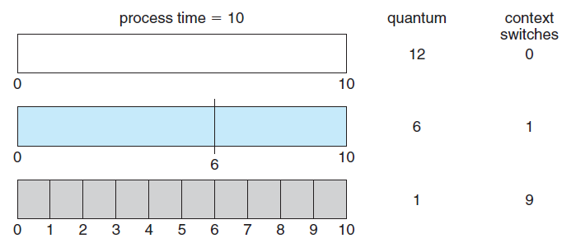
In contrast, if the time quantum is extremely small (say, 1 millisecond), the RR approach can result in a large number of context switches.
Assume, for example, that we have only one process of 10 time units. If the quantum is 12 time units, the process finishes in less than 1time quantum, with no overhead. If the quantum is 6 time units, however, the process requires 2 quanta, resulting in a context switch. If the time quantum is 1 time unit, then nine context switches will occur, slowing the execution of the process accordingly (Figure 6.4).

Slide 67
Thus, we want the time quantum to be large with respect to the context switch time. If the context-switch time is approximately 10 percent of the time quantum, then about 10 percent of the CPU time will be spent in context switching.
In practice, most modern systems have time quanta ranging from 10 to 100 milliseconds. The time required for a context switch is typically less than 10 microseconds; thus, the context-switch time is a small fraction of the time quantum.
Turnaround time also depends on the size of the time quantum. As we can see from Figure 6.5, the average turnaround time of a set of processes does not necessarily improve as the time-quantum size increases.
In general, the average turnaround time can be improved if most processes finish their next CPU burst in a single time quantum. For example, given three processes of 10 time units each and a quantum of 1 time unit, the average turnaround time is 29. If the time quantum is 10, however, the average turnaround time drops to 20.
If context-switch time is added in, the average turnaround time increases even more for a smaller time quantum, since more context switches are required.
Although the time quantum should be large compared with the context switch time, it should not be too large. As we pointed out earlier, if the time quantum is too large, RR scheduling degenerates to an FCFS policy. A rule of thumb is that 80 percent of the CPU bursts should be shorter than the time quantum.

Slide 68
A thread is a basic unit of CPU utilization; it comprises a thread ID, a program counter, a register set, and a stack.
It shares with other threads belonging to the same process its code section, data section, and other operating-system resources, such as open files and signals. A traditional (or heavyweight) process has a single thread of control.
If a process has multiple threads of control, it can perform more than one task at a time. Figure 4.1 illustrates the difference between a traditional single-threaded process and a multithreaded process.

Slide 69
PROCESSES AND THREADS
The concept of a process as embodies two characteristics:
• Resource ownership: A process includes a virtual address space to hold the process image; is the collection of program, data, stack, and attributes defined in the process control block. From time to time, a process may be allocated control or ownership of resources, such as main memory, I/O channels, I/O devices, and files. The OS performs a protection function to prevent unwanted interference between processes with respect to resources.
• Scheduling/execution: The execution of a process follows an execution path (trace) through one or more programs. This execution may be interleaved with that of other processes. Thus, a process has an execution state (Running, Ready, etc.) and a dispatching priority and is the entity that is scheduled and dispatched by the OS.

Slide 70
These two characteristics are independent and could be treated independently by the OS.
This is done in a number of operating systems, particularly recently developed systems.
To distinguish the two characteristics, the unit of dispatching is usually referred to as a thread or lightweight process , while the unit of resource ownership is usually referred to as a process or task .

Slide 71
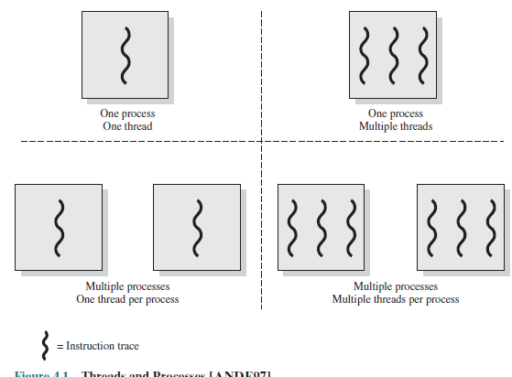
Multithreading
Multithreading refers to the ability of an OS to support multiple, concurrent paths of execution within a single process. The traditional approach of a single thread of execution per process, in which the concept of a thread is not recognized, is referred to as a single-threaded approach.

Slide 72
The two arrangements shown in the left half of Figure 4.1 are single-threaded approaches. MS-DOS is an example of an OS that supports a single user process and a single thread. Other operating systems, such as some variants of UNIX, support multiple user processes but only support one thread per process.
The right half of Figure 4.1 depicts multithreaded approaches. A Java run-time environment is an example of a system of one process with multiple threads.
In a multithreaded environment, a process is defined as the unit of resource allocation and a unit of protection. The following are associated with processes:
• A virtual address space that holds the process image
• Protected access to processors, other processes (for interprocess communication), files, and I/O resources (devices and channels)

Slide 73
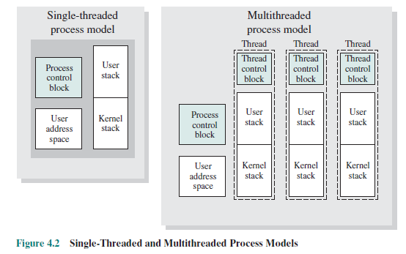
Within a process, there may be one or more threads, each with the following:
• A thread execution state (Running, Ready, etc.)
• A saved thread context when not running; one way to view a thread is as an independent program counter operating within a process
• An execution stack
• Some per-thread static storage for local variables
• Access to the memory and resources of its process, shared with all other threads in that process

Slide 74
Figure 4.2 illustrates the distinction between threads and processes from the point of view of process management.
In a single-threaded process model (i.e., there is no distinct concept of thread), the representation of a process includes its process control block and user address space, as well as user and kernel stacks to manage the call/return behavior of the execution of the process.
While the process is running, it controls the processor registers. The contents of these registers are saved when the process is not running.
In a multithreaded environment, there is still a single process control block and user address space associated with the process, but now there are separate stacks for each thread, as well as a separate control block for each thread containing register values, priority, and other thread-related state information.

Slide 75
Thus, all of the threads of a process share the state and resources of that process. They reside in the same address space and have access to the same data.
When one thread alters an item of data in memory, other threads see the results if and when they access that item. If one thread opens a file with read privileges, other threads in the same process can also read from that file.
The key benefits of threads derive from the performance implications:
1. It takes far less time to create a new thread in an existing process than to create a brand-new process.
2. It takes less time to terminate a thread than a process.
3. It takes less time to switch between two threads within the same process than to switch between processes.
4. Threads enhance efficiency in communication between different executing programs. In most operating systems, communication between independent processes requires the intervention of the kernel to provide protection and the mechanisms needed for communication. However, because threads within the same process share memory and files, they can communicate with each other without invoking the kernel.

Slide 76
Thus, if there is an application or function that should be implemented as a set of related units of execution, it is far more efficient to do so as a collection of threads rather than a collection of separate processes.
An example of an application that could make use of threads is a file server. As each new file request comes in, a new thread can be spawned for the file management program. Because a server will handle many requests, many threads will be created and destroyed in a short period.
If the server runs on a multiprocessor computer, then multiple threads within the same process can be executing simultaneously on different processors. Further, because processes or threads in a file server must share file data and therefore coordinate their actions, it is faster to use threads and shared memory than processes and message passing for this coordination.
The thread construct is also useful on a single processor to simplify the structure of a program that is logically doing several different functions.

Slide 77
Uses of threads in a single-user multiprocessing system:
• Foreground and background work: For example, in a spreadsheet program, one thread could display menus and read user input, while another thread executes user commands and updates the spreadsheet. This arrangement often increases the perceived speed of the application by allowing the program to prompt for the next command before the previous command is complete.
• Asynchronous processing: Asynchronous elements in the program can be implemented as threads. For example, as a protection against power failure, one can design a word processor to write its random access memory (RAM) buffer to disk once every minute. A thread can be created whose sole job is periodic backup and that schedules itself directly with the OS; there is no need for fancy code in the main program to provide for time checks or to coordinate input and output.

Slide 78
• Speed of execution: A multithreaded process can compute one batch of data while reading the next batch from a device. On a multiprocessor system, multiple threads from the same process may be able to execute simultaneously. Thus, even though one thread may be blocked for an I/O operation to read in a batch of data, another thread may be executing.
• Modular program structure: Programs that involve a variety of activities or a variety of sources and destinations of input and output may be easier to design and implement using threads.
In an OS that supports threads, scheduling and dispatching is done on a thread basis; hence, most of the state information dealing with execution is maintained in thread-level data structures. There are, however, several actions that affect all of the threads in a process and that the OS must manage at the process level.

Slide 79
Thread Functionality
Like processes, threads have execution states and may synchronize with one another.
THREAD STATES :
As with processes, the key states for a thread are Running, Ready, and Blocked. Generally, it does not make sense to associate suspend states with threads because such states are process-level concepts. In particular, if a process is swapped out, all of its threads are necessarily swapped out because they all share the address space of the process.
There are four basic thread operations associated with a change in thread state [ANDE04]:
• Spawn: Typically, when a new process is spawned, a thread for that process is also spawned. Subsequently, a thread within a process may spawn another thread within the same process, providing an instruction pointer and arguments for the new thread. The new thread is provided with its own register context and stack space and placed on the ready queue.

Slide 80
• Block: When a thread needs to wait for an event, it will block (saving its user registers, program counter, and stack pointers). The processor may now turn to the execution of another ready thread in the same or a different process.
• Unblock: When the event for which a thread is blocked occurs, the thread is moved to the Ready queue.
• Finish: When a thread completes, its register context and stacks are deallocated.

Slide 81
THREAD SYNCHRONIZATION :
All of the threads of a process share the same address space and other resources, such as open files. Any alteration of a resource by one thread affects the environment of the other threads in the same process.
It is therefore necessary to synchronize the activities of the various threads so that they do not interfere with each other or corrupt data structures. For example, if two threads each try to add an element to a doubly linked list at the same time, one element may be lost or the list may end up malformed.
The issues raised and the techniques used in the synchronization of threads are, in general, the same as for the synchronization of processes.

Slide 82
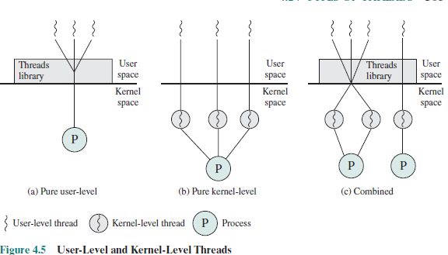
TYPES OF THREADS
There are two broad categories of thread implementation: user-level threads (ULTs) and kernel-level threads (KLTs). The latter are also referred to in the literature as kernel-supported threads or lightweight processes.
USER-LEVEL THREADS
In a pure ULT facility, all of the work of thread management is done by the application and the kernel is not aware of the existence of threads. Figure 4.5a illustrates the pure ULT approach.

Slide 83
Any application can be programmed to be multithreaded by using a threads library, which is a package of routines for ULT management.
The threads library contains code for creating and destroying threads, for passing messages and data between threads, for scheduling thread execution, and for saving and restoring thread contexts.
By default, an application begins with a single thread and begins running in that thread. This application and its thread are allocated to a single process managed by the kernel.
At any time that the application is running (the process is in the Running state), the application may spawn a new thread to run within the same process.
Spawning is done by invoking the spawn utility in the threads library. Control is passed to that utility by a procedure call.
The threads library creates a data structure for the new thread and then passes control to one of the threads within this process that is in the Ready state, using some scheduling algorithm.

Slide 84
When control is passed to the library, the context of the current thread is saved, and when control is passed from the library to a thread, the context of that thread is restored.
The context essentially consists of the contents of user registers, the program counter, and stack pointers.
All of the activity described in the preceding paragraph takes place in userspace and within a single process.
The kernel is unaware of this activity. The kernel continues to schedule the process as a unit and assigns a single execution state (Ready, Running, Blocked, etc.) to that process.

Slide 85
There are a number of advantages to the use of ULTs instead of KLTs, including the following:
1. Thread switching does not require kernel mode privileges because all of the thread management data structures are within the user address space of a single process. Therefore, the process does not switch to the kernel mode to do thread management. This saves the overhead of two mode switches (user to kernel; kernel back to user).
2. Scheduling can be application specific. One application may benefit most from a simple round-robin scheduling algorithm, while another might benefit from a priority-based scheduling algorithm. The scheduling algorithm can be tailored to the application without disturbing the underlying OS scheduler.
3. ULTs can run on any OS. No changes are required to the underlying kernel to support ULTs. The threads library is a set of application-level functions shared by all applications.

Slide 86
There are two distinct disadvantages of ULTs compared to KLTs:
1. In a typical OS, many system calls are blocking. As a result, when a ULT executes a system call, not only is that thread blocked, but also all of the threads within the process are blocked.
2. In a pure ULT strategy, a multithreaded application cannot take advantage of multiprocessing. A kernel assigns one process to only one processor at a time. Therefore, only a single thread within a process can execute at a time. In effect, we have application-level multiprogramming within a single process.

Slide 87
KERNEL-LEVEL THREADS In a pure KLT facility, all of the work of thread management is done by the kernel. There is no thread management code in the application level, simply an application programming interface (API) to the kernel thread facility. Windows is an example of this approach.
Figure 4.5b depicts the pure KLT approach. The kernel maintains context information for the process as a whole and for individual threads within the process. Scheduling by the kernel is done on a thread basis. This approach overcomes the two principal drawbacks of the ULT approach.
First, the kernel can simultaneously schedule multiple threads from the same process on multiple processors.
Second, if one thread in a process is blocked, the kernel can schedule another thread of the same process. Another advantage of the KLT approach is that kernel routines themselves can be multithreaded.
The principal disadvantage of the KLT approach compared to the ULT approach is that the transfer of control from one thread to another within the same process requires a mode switch to the kernel

Slide 88
COMBINED APPROACHES
Some operating systems provide a combined ULT/ KLT facility ( Figure 4.5c ). In a combined system, thread creation is done completely in user space, as is the bulk of the scheduling and synchronization of threads within an application.
The multiple ULTs from a single application are mapped onto some (smaller or equal) number of KLTs. The programmer may adjust the number of KLTs for a particular application and processor to achieve the best overall results.
In a combined approach, multiple threads within the same application can run in parallel on multiple processors, and a blocking system call need not block the entire process.
If properly designed, this approach should combine the advantages of the pure ULT and KLT approaches while minimizing the disadvantages.
Solaris is a good example of an OS using this combined approach. The current Solaris version limits the ULT/KLT relationship to be one-to-one.

Slide 89
Other Arrangements
The other two combinations have also been investigated, namely, a many-to-many relationship and a one-to-many relationship.
MANY-TO-MANY RELATIONSHIP
The idea of having a many-to-many relationship between threads and processes has been explored in the experimental operating system TRIX [PAZZ92, WARD80].
In TRIX, there are the concepts of domain and thread.
A domain is a static entity, consisting of an address space and “ports” through which messages may be sent and received.
A thread is a single execution path, with an execution stack, processor state, and scheduling information.

Slide 90
As with the multithreading approaches discussed so far, multiple threads may execute in a single domain, providing the efficiency gains discussed earlier.
However, it is also possible for a single user activity, or application, to be performed in multiple domains. In this case, a thread exists that can move from one domain to another.
The use of a single thread in multiple domains seems primarily motivated by a desire to provide structuring tools for the programmer.
For example, consider a program that makes use of an I/O subprogram. In a multiprogramming environment that allows user-spawned processes, the main program could generate a new process to handle I/O and then continue to execute.
However, if the future progress of the main program depends on the outcome of the I/O operation, then the main program will have to wait for the other I/O program to finish.

Slide 91
There are several ways to implement this application:
1. The entire program can be implemented as a single process. This is a reasonable and straightforward solution. There are drawbacks related to memory management.
The process as a whole may require considerable main memory to execute efficiently, whereas the I/O subprogram requires a relatively small address space to buffer I/O and to handle the relatively small amount of program code.
Because the I/O program executes in the address space of the larger program, either the entire process must remain in main memory during the I/O operation or the I/O operation is subject to swapping.
This memory management effect would also exist if the main program and the I/O subprogram were implemented as two threads in the same address space.

Slide 92
2. The main program and I/O subprogram can be implemented as two separate processes. This incurs the overhead of creating the subordinate process. If the I/O activity is frequent, one must either leave the subordinate process alive, which consumes management resources, or frequently create and destroy the subprogram, which is inefficient.
3. Treat the main program and the I/O subprogram as a single activity that is to be implemented as a single thread. However, one address space (domain) could be created for the main program and one for the I/O subprogram.
Thus, the thread can be moved between the two address spaces as execution proceeds. The OS can manage the two address spaces independently, and no process creation overhead is incurred. Furthermore, the address space used by the I/O subprogram could also be shared by other simple I/O programs.
The experiences of the TRIX developers indicate that the third option has merit and may be the most effective solution for some applications.

Slide 93
ONE-TO-MANY RELATIONSHIP
In the field of distributed operating systems (designed to control distributed computer systems), there has been interest in the concept of a thread as primarily an entity that can move among address spaces.
A notable example of this research is the Clouds operating system, and especially its kernel.
A thread in Clouds is a unit of activity from the user’s perspective. A process is a virtual address space with an associated process control block.
Upon creation, a thread starts executing in a process by invoking an entry point to a program in that process.
Threads may move from one address space to another and actually span computer boundaries (i.e., move from one computer to another).

Slide 94
As a thread moves, it must carry with it certain information, such as the controlling terminal, global parameters, and scheduling guidance (e.g., priority).
The Clouds approach provides an effective way of insulating both users and programmers from the details of the distributed environment.
A user’s activity may be represented as a single thread, and the movement of that thread among computers may be dictated by the OS for a variety of system-related reasons, such as the need to access a remote resource, and load balancing.

Slide 95
MULTICORE AND MULTITHREADING
The use of a multicore system to support a single application with multiple threads, such as might occur on a workstation, a video-game console, or a personal computer running a processor-intense application, raises issues of performance and application design.
Performance of Software on Multicore
The potential performance benefits of a multicore organization depend on the ability to effectively exploit the parallel resources available to the application. Let us focus first on a single application running on a multicore system. Amdahl’s law states that:
Speedup =time to execute program on a single processor/time to execute program on N parallel processors = 1/((1 - f ) +f/N)
The law assumes a program in which a fraction (1 - f) of the execution time involves code that is inherently serial and a fraction f that involves code that is infinitely parallelizable with no scheduling overhead.

Slide 96
This law appears to make the prospect of a multicore organization attractive. But even a small amount of serial code has a noticeable impact. If only 10% of the code is inherently serial ( f = 0.9) , running the program on a multicore system with eight processors yields a performance gain of only a factor of 4.7.
In addition, software typically incurs overhead as a result of communication and distribution of work to multiple processors and cache coherence overhead.
This results in a curve where performance peaks and then begins to degrade because of the increased burden of the overhead of using multiple processors.
In addition to general-purpose server software, a number of classes of applications benefit directly from the ability to scale throughput with the number of cores. [MCDO06] lists the following examples:

Slide 97
• Multithreaded native applications: Multithreaded applications are characterized by having a small number of highly threaded processes. Examples of threaded applications include Lotus Domino or Siebel CRM (Customer Relationship Manager).
• Multiprocess applications: Multiprocess applications are characterized by the presence of many single-threaded processes. Examples of multiprocess applications include the Oracle database, SAP, and PeopleSoft.
• Java applications: Java applications embrace threading in a fundamental way. Java Virtual Machine is a multithreaded process that provides scheduling and memory management for Java applications. Java applications that can benefit directly from multicore resources include application servers such as Sun’s Java Application Server, BEA’s Weblogic, IBM’s Websphere, and the open-source Tomcat application server.
Multiinstance applications: Even if an individual application does not scale to take advantage of a large number of threads, it is still possible to gain from multicore architecture by running multiple instances of the application in parallel.

